Slide 1

ES3315: ES Project A Practical Model for the Evaluation of High School Student Performance Based on Machine Learning
KORRA MAHESH
ES19BTECH11013
IIT HYDERABAD
Guide: Dr. ADITYA SIRIPURAM

Slide 2
Aim of the project
MLs can collect information about how students acted and can evaluate this performance.
The evaluation of student performance refers to how much a student approaches the educational goals and specifies how well a student learned, how motivated to learn a student is or how good the teaching method was.

Slide 3
Data
Here we have the data of 649 students with 33 attributes.
The data attributes include student grades, demographic, social and school related features and it was collected by using school reports and questionnaires.

Slide 4
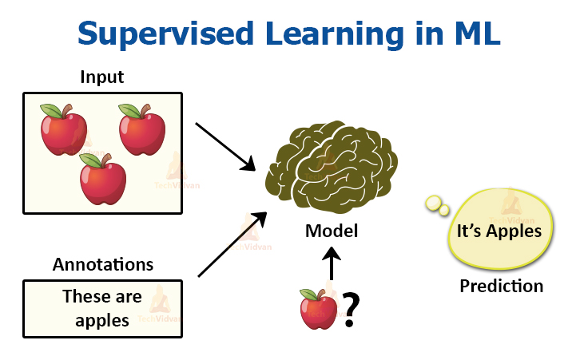
Methods
In this project we use four different supervised learning algorithms.
Logistic regression
K-Nearest Neighbor
Support vector machine
Random Forest Classifier

Slide 5
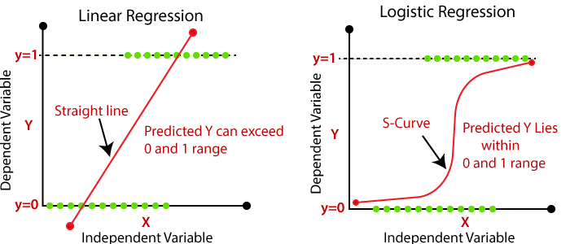
Logistic regression
Logistic Regression is a “Supervised machine learning” algorithm that can be used to model the probability of a certain class or event. It is used when the data is linearly separable and the outcome is binary or dichotomous in nature. That means Logistic regression is usually used for Binary classification problems.

Slide 6
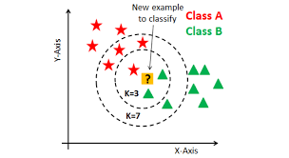
K-Nearest Neighbor
The abbreviation KNN stands for “K-Nearest Neighbor”. It is a supervised machine learning algorithm. The algorithm can be used to solve both classification and regression problem statements. The number of nearest neighbours to a new unknown variable that has to be predicted or classified is denoted by the symbol 'K'.

Slide 7
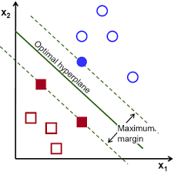
Support vector machine
In machine learning, support-vector machines (SVMs, also support-vector networks) are supervised learning models with associated learning algorithms that analyze data for classification and regression analysis.
The goal of the SVM algorithm is to create the best line or decision boundary that can segregate n-dimensional space into classes so that we can easily put the new data point in the correct category in the future. This best decision boundary is called a hyperplane.

Slide 8
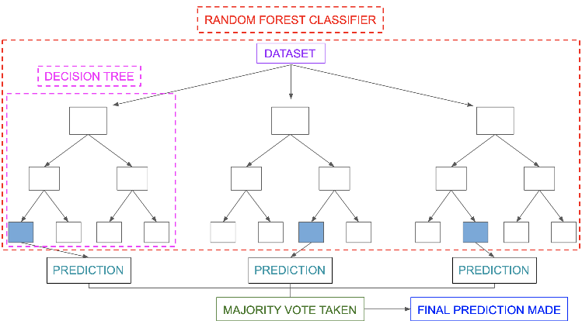
Random Forest Classifier
Random Forest Regression is a supervised learning algorithm for regression that use the ensemble learning method. Ensemble learning is the process of strategically generating and combining many models, such as classifiers or experts, to solve a computer intelligence problem.
A random forest produces good predictions that can be understood easily. It can handle large datasets efficiently. The random forest algorithm provides a higher level of accuracy in predicting outcomes over the decision tree algorithm.

Slide 9
Confusion Matrix in Machine Learning
 | Prediction
Truth |  | Fail | Pass
Truth | Fail | True Negative (TN) | False Positive (FP)
 | Pass | False Negative (FN) | True Positive (TP)

Slide 10
Evaluation Metrics for Machine Learning Models
Accuracy
Accuracy = (TP+TN)/(TP+FP+FN+TN)
F1 score
F1 Score = 2*(Recall * Precision) / (Recall + Precision)
Recall
Recall = TP/(TP + FN)
Precision
Precision = TP/(TP + FP)

Slide 11
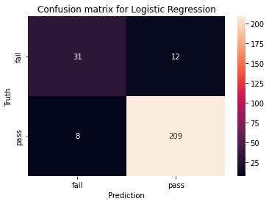
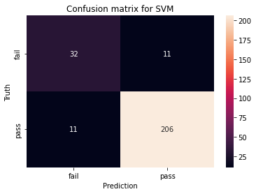
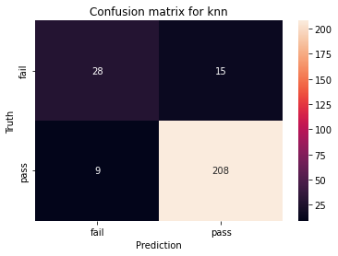
Confusion Matrix of each Model
Logistic regression
K-Nearest Neighbors k =3
Support vector machine
Random Forest Classifier Max depth = 3

Slide 12
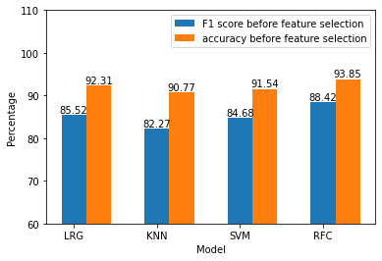
Graph for Accuracy and F1 score before feature selection

Slide 13
Result of each Model
Logistic regression
Precision = TP/(TP + FP) = 0.946
Recall = TP/(TP + FN)= 0.963
Accuracy in % = 92.3076923076923
F1 score = 85.52177302594944
K-Nearest Neighbors k = 3
Precision = TP/(TP + FP) = 0.933
Recall = TP/(TP + FN)= 0.959
Accuracy in % = 90.76923076923077
F1 score = 82.27272727272728
Support vector machine
Precision = TP/(TP + FP) = 0.949
Recall = TP/(TP + FN)= 0.949
Accuracy in % = 91.53846153846153
F1 score = 84.67474011359982
Random Forest Classifier Max depth = 3
Precision = TP/(TP + FP) = 0.955
Recall = TP/(TP + FN)= 0.972
Accuracy in % = 93.84615384615384
F1 score = 88.41741842075955

Slide 14
BorutaPy Function
Borutapy random forest based feature selection method, which provides stable selection of important and non important attributes.
Borutapy iteratively removes features that are statically less relevant.

Slide 15
Selected Feature
Attribute Information:
1 failures - number of past class failures (numeric: n if 1<=n <3, else 4)
2 G1 - first period grade (numeric: from 0 to 20)
3 G2 - second period grade (numeric: from 0 to 20)
4 G3 - final grade (numeric: from 0 to 20, output target)

Slide 16
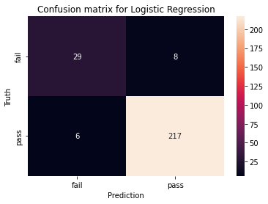

Confusion Matrix of each Model after Borutapy
Logistic regression
K-Nearest Neighbors
k=10
Support vector machine
Random Forest Classifier
Max depth = 3

Slide 17
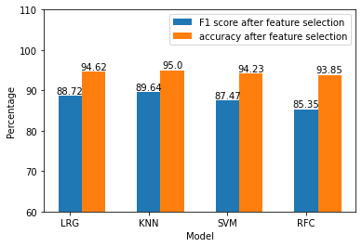
Graph for Accuracy and F1 score After feature selection

Slide 18
Result of each Model after BorutaPy
Logistic regression
Precision = TP/(TP + FP) = 0.964
Recall = TP/(TP + FN)= 0.973
Accuracy in % = 94.61538461538461
F1 score = 88.71527777777777
K-Nearest Neighbors
k=10
Precision = TP/(TP + FP) = 0.969
Recall = TP/(TP + FN)= 0.973
Accuracy in % = 95.0
F1 score = 89.64175170849806
Support vector machine
Precision = TP/(TP + FP) = 0.956
Recall = TP/(TP + FN)= 0.978
Accuracy in % = 94.23076923076923
F1 score = 87.4674636074424
Random Forest Classifier
Max depth = 3
Precision = TP/(TP + FP) = 0.940
Recall = TP/(TP + FN)= 0.991
Accuracy in % = 93.84615384615384
F1 score = 85.35004930271869

Slide 19
Comparison Of Results
Accuracy and F1 score of all Models Before Feature Selection
Accuracy and F1 score of all Models After Implementation of BorutaPy Function
metric | Logistic regression | KNN | SVM | RFC
f1 score | 85.522 | 82.273 | 84.675 | 88.417
accuracy % | 92.308 | 90.769 | 91.538 | 93.846
confusion matrix | [31 12] [ 8 209] | [28 15] [ 9 208] | [32 11] [ 11 206] | [33 10] [ 6 211]
metric | Logistic regression | KNN | SVM | RFC
f1 score | 88.715 | 89.642 | 87.467 | 85.35
accuracy % | 94.615 | 95.0 | 94.231 | 93.846
confusion matrix | [29 8] [ 6 217] | [30 7] [ 6 217] | [27 10] [ 5 218] | [23 14] [ 2 221]

Slide 20
Graph for Accuracy and F1 score before feature selection
Graph for Accuracy and F1 score After feature selection

Slide 21
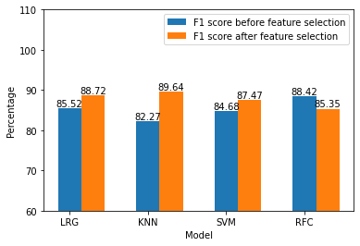
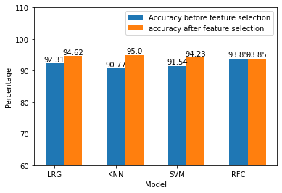
Comparison of F1 score with and without feature selection
Comparison of Accuracy with and without feature selection

Slide 22
Conclusion
By using feature selection method we can get better results.
After feature selection, we can better forecast using KNN method.
We can improve the student performance by watching their eye angles using deep learning algorithm.

Slide 23
Reference
Source paper:
https://www.mdpi.com/2076-3417/11/23/11534/htm
Authors: Mostafa Zafari, Abolghasem Sadeghi-Niaraki, Soo-Mi Choi and Ali Esmaeily

Slide 24
THANK YOU

